Slide 1
Microsoft Graph Workshop
Cozone Leidsche Rijn,
Carl in ‘t Veld, 15-03-2017

Slide 2
Azure Portal and Office365 Access
Create your own demo tenant via http://microsoftofficedemos.com/
Access through https://portal.office.com/ and https://portal.azure.com/
My demo tenant credentials:
admin@mod49861.onmicrosoft.com
pass@word1

Slide 3
What is Microsoft Graph
Exercise 1: Authentication
Exercise 2: Getting my Office Groups
Exercise 3: Navigating through the Video Portal
Exercise 4: hookup up incoming e-mails

Slide 4
What is Microsoft Graph

Slide 5

Office 365 by the numbers
4
Trillion Emails sent with Office 365
50
Million objects in the directory
60
Billion attachments
470
Petabytes of data
8
Billion relationships in Office graph
850
Million meetings per month
70%
Fortune500 companies
purchased Office 365
in the last 12 months

Slide 6
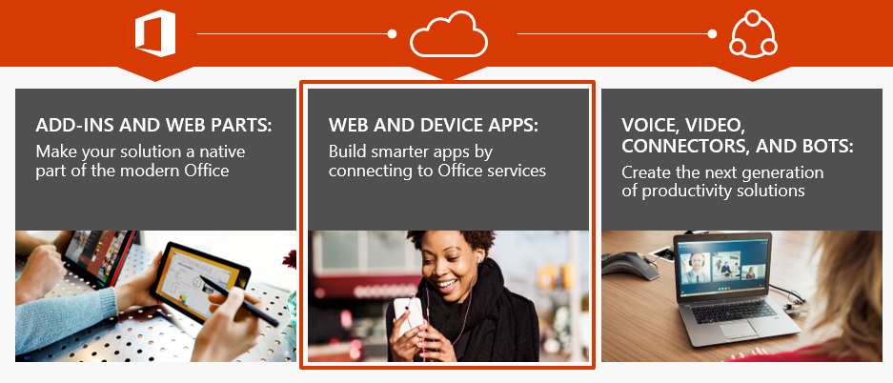
Office platform What can I build?

Slide 7
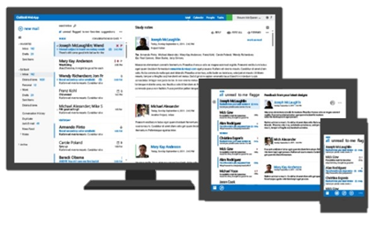
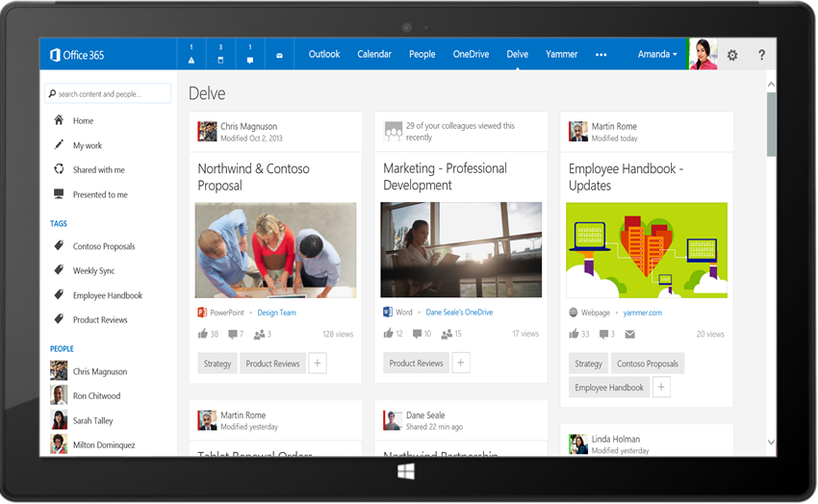
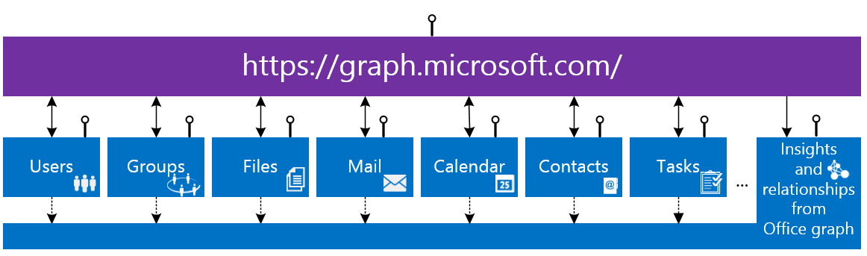
Microsoft Graph API
Your App
https://graph.microsoft.com/

Slide 8
Unified API Style & Single Endpoint
https://graph.microsoft.com
Operation | Service Endpoint
GET my profile | https://graph.microsoft.com/v1.0/me
GET my files | https://graph.microsoft.com/v1.0/drive/root/children
GET my photo | https://graph.microsoft.com/v1.0/photo/$value
GET my mail | https://graph.microsoft.com/v1.0/me.messages
GET my calendar | https://graph.microsoft.com/v1.0/me/calendar
GET my manager | https://graph.microsoft.com/v1.0/me/manager
GET group conversations | https://graph.microsoft.com/v1.0/groups/<id>/conversations
GET files trending around me | https://graph.microsoft.com/v1.0/me/insights/trending

Slide 9

Graph, Graph, Graph
Azure AD Graph
Open Graph
Office Graph
GQL
Office 365 Unified API
Microsoft Graph
….
Notes:
Azure AD Graph = Active directory API
Open Graph = Yammmer query api
Office Graph = the analytics system behind delve and many of the relations and can be queried either by SharePoint or Microsoft Graph
GQL is the Graph Query Language behind the Office Graph
Microsoft Graph is the Office 365 Unified API

Slide 10
Authentication
ADAL v1.0
MSAL v2.0 (preview)
Authentication library to deal with Azure Active Directory authentication flow
Support for Work and School accounts via Azure Active Directory
Full set of SDKs available
Supports Office 365 Services
User gives consent for all permissions at first start
Unified authentication libary to deal with authentication across the different identity platforms provided by Microsoft
Support for Work, School and Personal accounts – No Azure requirement
User gives consent when the applications needs it
Notes:
https://azure.microsoft.com/en-us/documentation/articles/active-directory-v2-compare/
Restrictions: https://azure.microsoft.com/en-us/documentation/articles/active-directory-v2-limitations/

Slide 11
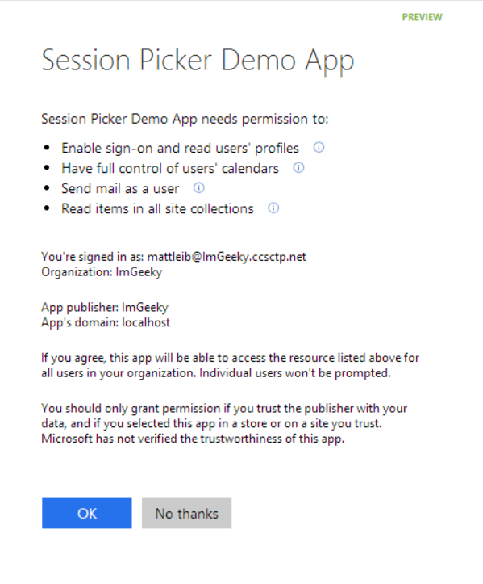
ADAL - Azure Active Directory and Office 365
Single auth flow for O365
Sign users in using OpenID Connect
Azure AD, Exchange, SharePoint, Yammer, OneNote
Device apps, web sites, SPAs, and service apps
Admin and end-user consent
Secure protocol
OpenID Connect and OAuth 2.0
No capturing user credentials
Fine-grained access scopes
Supports MFA and federated user sign-in
Long-term access through refresh tokens

Slide 12
Consent
User Consent
Consent provided by the user
Any user in the organisation can install the application
Implemented by default, but can be switched off by the Office 365 Admin
User can revoke consent through http://myapps.microsoft.com
Admin Consent
Consent provided by an Office 365 Global Administrator
Only Office 365 global administrators
Consent is given to all users in the organisation
Only required for multi-tenant applications or native applications

Slide 13
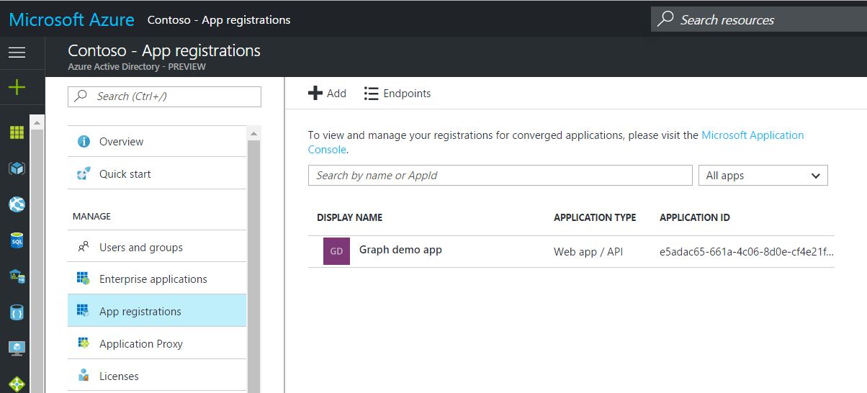
Register your Application
Sign in to the Azure Management Portal https://portal.azure.com/
Create a new application
Select the Scope (Single / Multi-Tenant)
Get Client ID
Generate Client Secret (Web apps only)
Add Redirect URLs https://localhost:44315/
Select Permissions

Slide 14
Autentication to Office 365
Azure AD Authorization
Endpoint
Azure AD Token
Endpoint
Your Application
Microsoft Graph API
Request authorization code
Sign-in via browser pop-up
Return authorization code
Redeem authorization code and acquire access token for Office 365 resource
Return id, access, and refresh tokens
Call Microosft Graph API using the access token
Return Http Response
Notes:
Authorization flow

Slide 15
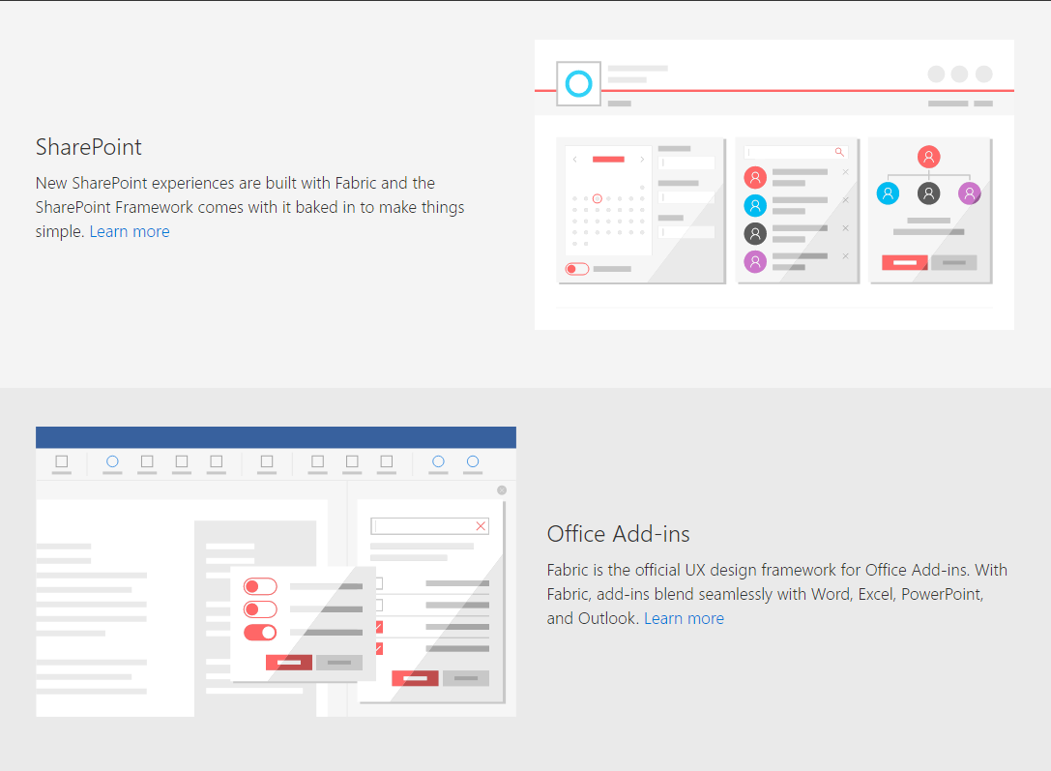
Office UI Fabric https://dev.office.com/fabric

Slide 16
Documentation
https://graph.microsoft.io/
https://docs.microsoft.com/
https://dev.office.com/fabric
Examples: https://github.com/azure-samples?query=active-directory
Questions: https://stackoverflow.com/questions/tagged/microsoftgraph

Slide 17
Exercise 1: Authentication

Slide 18
Web.config
<add key="ida:ClientID" value="e5adac65-661a-4c06-8d0e-cf4e21fe7746" />
<add key="ida:Password" value="a2yC/Q2yGqi8ilDJAJEdZBdme6hb+SKS0jyewfoVcSI=" />
<add key="ida:O365TenantId" value="mod498161" />
<add key="ida:AadTenantId" value="ec40371a-a53f-434c-9454-551ebf394e0a" />
Bonus:
Enable logging in with your Capgemini Microsoft work-account: use multi-tenant and “common” as AADTenantId This will not work with the next exercises. Why?
Notes:
The answer to the question: the other exercises leverage admin-only permissions. We are not the tenant-admin of Capgemini’s!

Slide 19
Exercise 2: Getting my office Groups

Slide 20
Some instructions
Service:
Add the following rest-call in order to retrieve the groups from Graph: https://graph.microsoft.com/v1.0/me/memberOf/$/microsoft.graph.group
Controller:
repoMSGraph.GetGroups(); in order to get the groups and assign it to the view model
View:
Add nav-link to GroupsController/Index
We are leveraging https://dev.office.com/fabric
Code on next slide
Required (delegated) permissions:
Graph/Group.Read.All

Slide 21
Code for groups view
<div class="ms-Grid-col ms-u-sm3">
<div class="ms-Persona">
<div class="ms-Persona-imageArea">
<div class="ms-Persona-initials ms-Persona-initials--blue">
@item.DisplayName.Substring(0, 2).ToUpper()
</div>
<img class="ms-Persona-image" src="images/GetGroupImage?groupid=@item.Id">
@* this construction is required we need to fetch the group images asynchronously *@
</div>
<div class="ms-Persona-details">
<div class="ms-Persona-primaryText" title="@item.DisplayName">
<a href="@item.ConversationsUrl" target="_blank">@item.DisplayName</a>
</div><div class="ms-Persona-secondaryText" title="@item.Description">@item.Description</div>
</div>
</div>
</div>

Slide 22
Resetting your app after new permissions
Delete ASP.NET Cookie
Revoke consent via http://myapps.microsoft.com
Recycle apppool

Slide 23
Exercise 3: Navigating through the Video Portal

Slide 24
Some instructions
Service:
Add the following rest-call in order to retrieve channels and videos from the video portal end-point: SpHelper.GetVideoPortalRootUrl() + "/_api/VideoService/Channels?$top=2000&$skip=0&$select=id,title,tilehtmlcolor&$orderby=title"
var query = string.Format("{0}/_api/VideoService/Channels('{1}')/Videos('{2}')",
await SpHelper.GetVideoPortalRootUrl(), channelId, videoId);
Channel and Video Controllers:
VideoChannelRepository.GetChannels(); in order to get all available video channels
VideoChannelRepository.GetChannelVideos(channelId); in order to get the videos and assign it to the view model
View:
Add a nav-link to ChannelController/Index
Code on next slides
Required (delegated) permissions:
SharePoint/AllSites.Read

Slide 25
Code for channels view
<a href="@Url.Action("Index", "Video", new { channelId = item.Id })" class="ChannelGroup-channel ms-fontColor-neutralSecondary ms-Grid-col ms-u-sm12 ms-u-md6 ms-u-xl4" style="border-color: @item.HtmlColor">@item.Title</a>

Slide 26
Code for video view
<div class="VideoList-item ms-Grid-col ms-Grid ms-u-sm12 ms-u-md6 ms-u-lg4 ms-u-xl3">
<div class="ms-Grid-row">
<div class="VideoList-thumb ms-Grid-col ms-u-sm12 ms-u-lg12">
<a href="@Url.Action("Index", "Player", new { channelId = item.ChannelId, videoId = item.VideoId })" class="VideoList-thumbLink">
<img class="VideoList-thumbImg" src="/images/GetVideoThumbnail?channelid=@item.ChannelId&videoid=@item.VideoId&preferredwidth=275" alt="@item.Title">
@*<img class="VideoList-thumbImg" src="@item.ThumbnailUrl" alt="@item.Title">*@
<span class="VideoList-thumbCaption">@HtmlHelpers.ShowHHMMSS(item.DurationInSeconds)</span>
</a>
</div>
<div class="VideoList-text ms-Grid-col ms-u-sm12 ms-u-lg12">
<a href="@Url.Action("Index", "Player", new { channelId = item.ChannelId, videoId = item.VideoId })"><span class="VideoList-title ms-font-m-plus" title="@item.Title">@item.Title</span></a>
<span class="VideoList-viewCount ms-font-s-plus ms-fontColor-neutralSecondaryAlt">@item.ViewCount views</span>
</div>
</div>
</div>

Slide 27
Exercise 4: hookup up incoming e-mails

Slide 28
Webhooks
Microsoft Graph REST API clients can subscribe to changes:
Messages
Events
Contacts
Group conversations
Drive root items

Slide 29
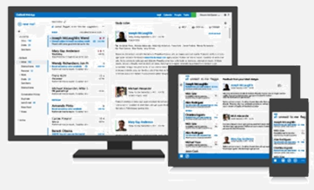
Webhooks
Your App
1. CREATE
/notifications
2. VALIDATE
3. NOTIFY
/subscriptions
Outlook Apps
graph.microsoft.com
outlook.com

Slide 30
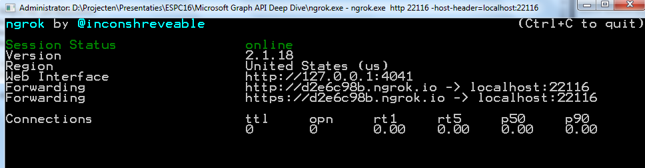
NGROK
Download ngrok: https://ngrok.com/
Webhook requires a public endpoint for sending its notifications
When developing, your notification endpoint is running on https://localhost
Use NGROK to tunnel the requests from a public endpoint to http://localhost
ngrok.exe http 22116 -host-header=localhost:22116

Slide 31
Some instructions
Navigation:
Add a nav link to SubscriptionController/Index
Web.config:
<add key="ida:NotificationUrl" value="https://20506596.ngrok.io/notification/listen" />
The following example has been adopted:
https://github.com/microsoftgraph/aspnet-webhooks-rest-sample
Required permission: Exchange/Mail.Read
As soon as the subscription is being monitored, send a mail to the logged-in user.

Slide 32
Colour Palette
Title Text
Body Text
Accent 1
Accent 2
Accent 3
Accent 4
Accent 5
Accent 6
Hyperlink
Followed Hyperlink

